Slide 1
POWER BI AND SQL
Project: Internet Sales Report

Slide 2
Introduction
Dataset used in this project is downloaded from Microsoft.com and this database is free to download.
Tools that will be used in this project is SQL to clean the dataset and the data will be saved in .csv format. The .csv file will be uploaded into Power BI tools for data visualization.

Slide 3
Work Flow
Identify Objectives
03
Cleaning Dataset
05
Prepare dashboard fulfill objective requirement
01
02
Find Dataset
04
Upload Cleaned dataset(.csv) into POWER BI
Upload to github
06

Slide 4
Objetives
To find the best sold item.
Identify the highest spent client who have bought their product.
Evaluating the sales performance over time and contrasting it with the budget.

Slide 5
The Dataset
Dataset page download link: CLICK
Dataset name: AdventureWorksDW2022.bak
The Dataset need to be update using this script.
Youtube Tutorial used for this project : LINK

Slide 6
Cleaning Dataset
The tool that will be used in this project is SQL Server Management Studio Management Studio 19 (SMSS).
The Step: Data cleaning on the dataset AdventureWorksDW2022.bak for table DimCustomer, DimDate, DimFactInternet and DimProduct.
The queries:

Slide 7
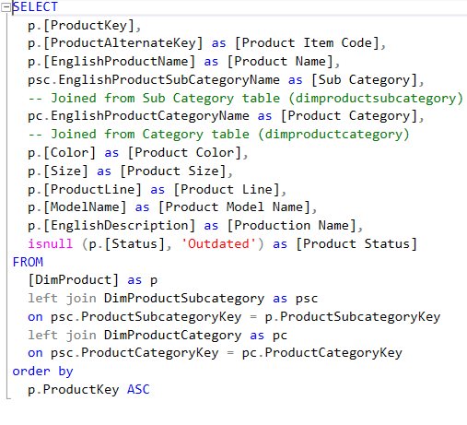
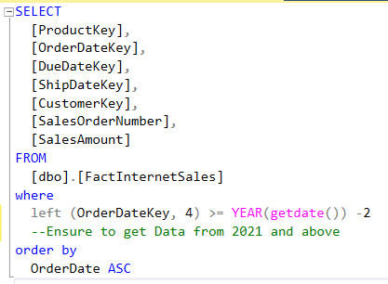
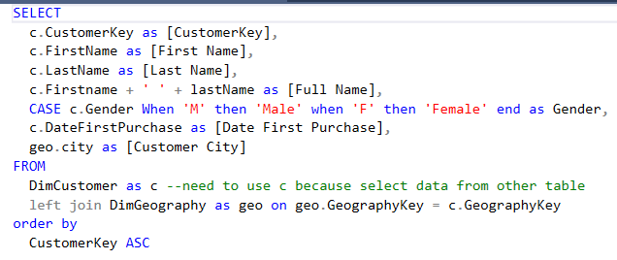
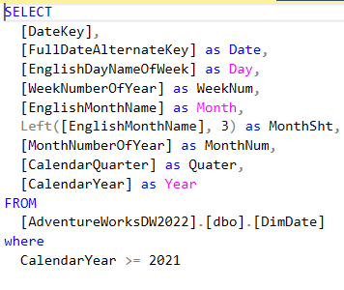
The Queries

Slide 8
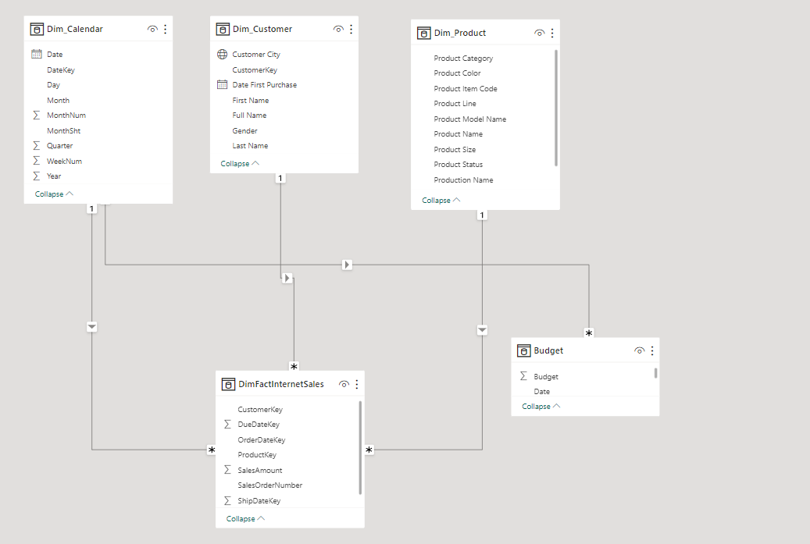
Excel File
The result from executed queries of AdventureWorksDW2022.bak will be saved into excel file (.csv) and then will be uploaded into POWER BI
There is another excel file called budget created as a example budget from the client. I adjusted the budget’s amount from the tutorial that will be explain in the next slide.
Each table is connected using the data modelling therefore data integration is enabled.

Slide 9
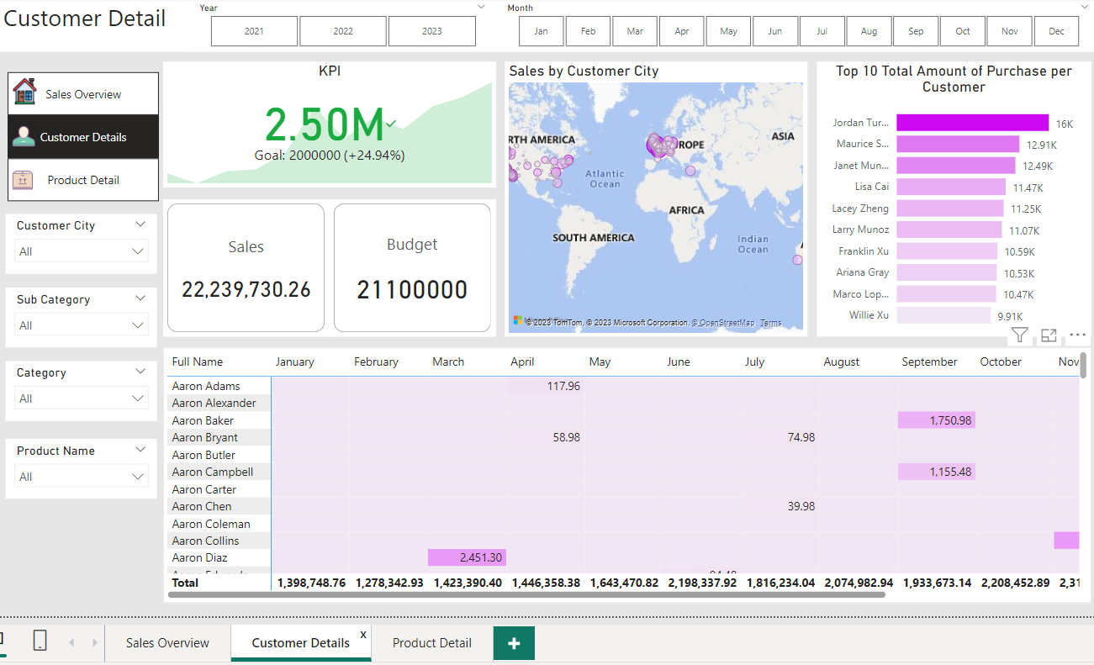
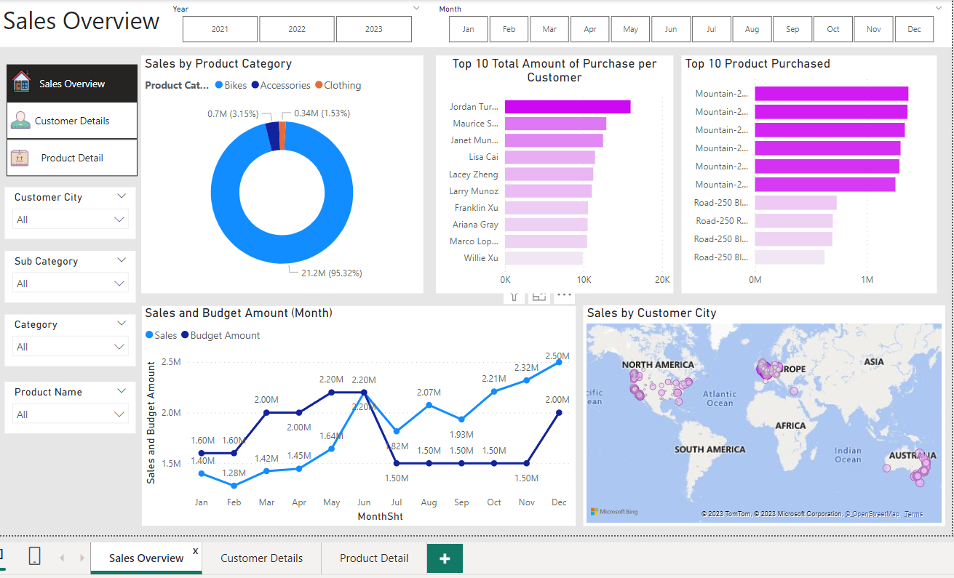
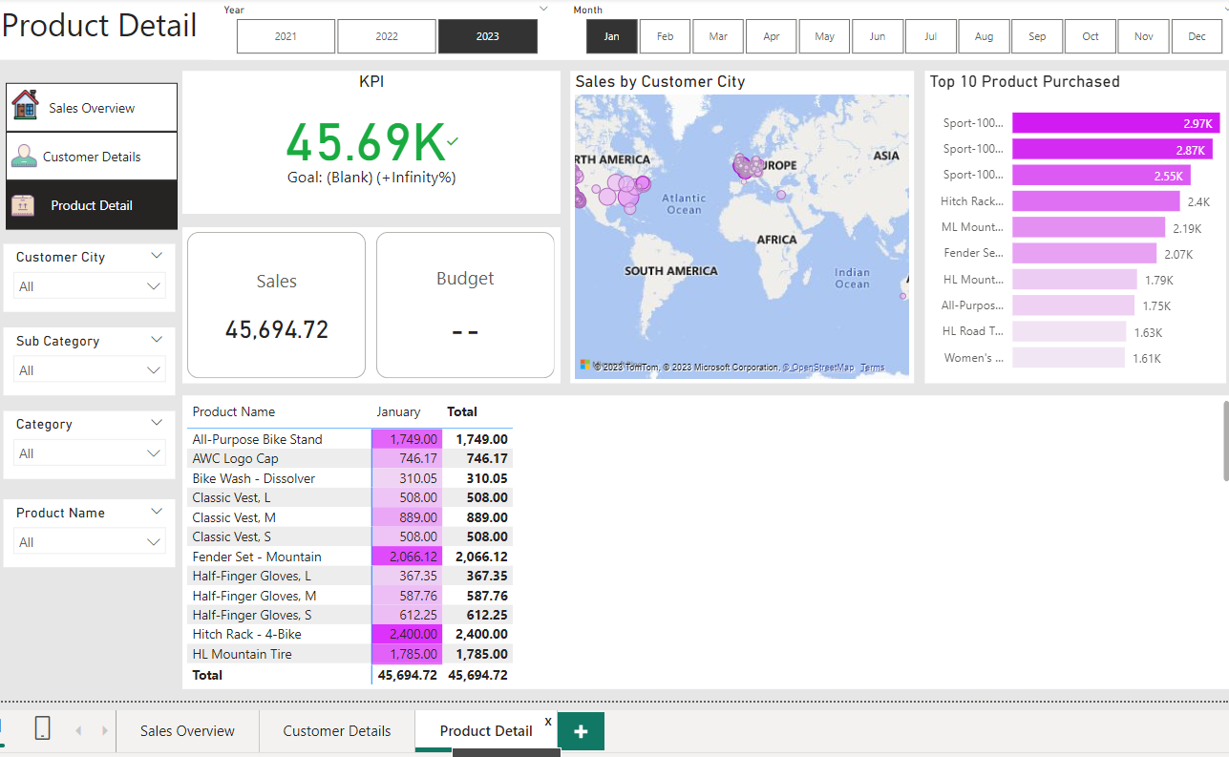
Interactive Data Visualization
Sales Overview, Customer detail and Product detail page created using the data.
The tutorial used data from 2019 to 2021. I adjusted the data used in the dataset which is from 2021 to Jan 2023.

Slide 10
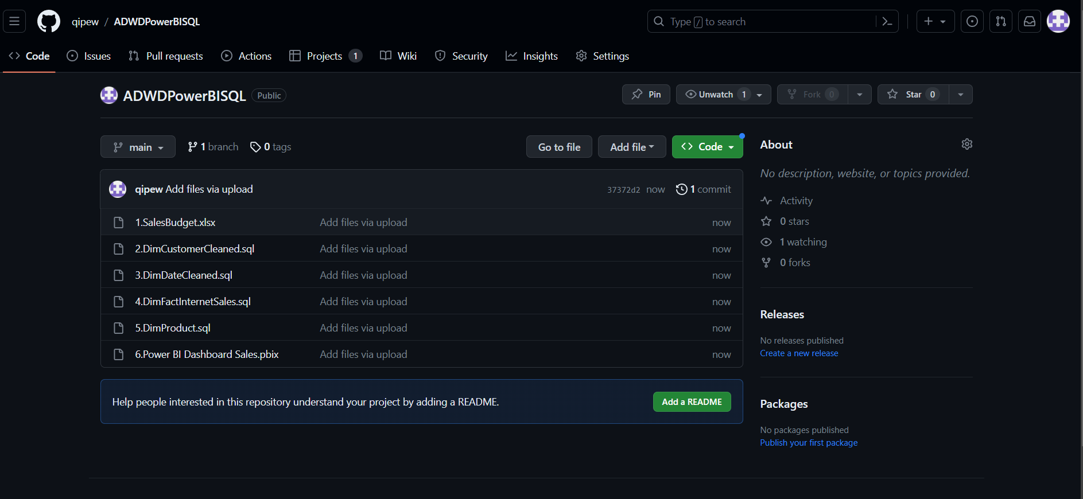
Upload file to Github
The file is uploaded into my own GitHub account: CLICK

Slide 11
Conclusion
From the data visualization, we can conclude that:
The most product purchased is Mountain-200 black, 46 with total of $1.37M
Highest spent customer is Jordan Turner, $16k
The trend show that customer tend to buy their product at the end of the year and sale will most likely to decline on January each year.

